Slide 1
Event Driven Framework

Slide 2
Introduction
To be added
Suggestions needed for this section
And corrections for rest sections

Slide 3
Technologies to be used
Front-End Development
Boot-Strap CSS (Useful for creating Responsive Web Pages for All Devices)
Java Script (Useful for Creating Animations and Graphs in the Web App)
D3.js (Data Driven Document Framework Useful For Creating Graphs in Real-Time)
Back-End Development
Node.js (Useful for handling the server side of the Web Application)
Apache Kafka (Distributed Streaming Platform Used for Handling Response and Request Queries, Also acts as a Query Processor for an item/Event to be Produced by a Producer and to be Consumed By a Consumer)
Apache Storm (Stream Processing Framework for Real-time Data)

Slide 4
Description About the framework
The framework will consist of 3 phases namely
Data Fetching phase (*From user to Apache Kafka which will also include Query processing and the use of Stream Processing the real-time data)
Data Requests phase (*From Kafka to user i.e. distinguished topic wise)
Processing and Display phase (*Phase is restricted to user only)
Data fetching phase constitutes the most part of this Framework. Data will be fetched from pinnacle’s servers. Fetching process is done only on trigger of specific events hence the name Event Driven Framework.
Data will be requested from Kafka servers which will respond with a distinct topic in which the data from the producer has been classified.
Processing includes breaking down of data into logs and records and also representing useful information for the dashboard.

Slide 5
Front End Technologies
Boot-strap CSS :- CSS will be used to style the user’s view of the dashboard. It basically has containers such that the content inside them will be automatically resized according to the screen width and height.
JavaScript :- It is versatile as it will be used both in out Front end and Back end. In the front end part JavaScript handles the animation and event handling part to make it easier for Boot-strap CSS. Boot-strap CSS sits on top of a JavaScript layer which is used without the knowledge of the user.
D3.js :- It is a Data Driven Document framework which will be used for the representation of data in a graphical or pictorial format. This can also read data from local system in formats such as .csv, .JSON etc. which can further be used to plot graphs based on the input data.

Slide 6
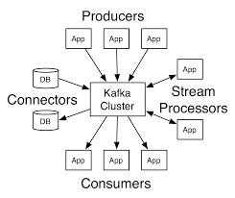
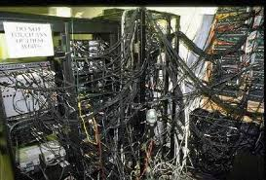
Apache Kafka
We use Apache Kafka as a robust queue which is distributed, can handle high volumes of data and enables us to pass messages from one computer to another.
In the picture Kafka cluster will handle all the requests from a consumer.
Producer consumer relation can be very messy. Apache Kafka handles all the message passing as a central unit.
We can integrate a
Stream processor with it
Which will further streamline
Out message passing.

Slide 7
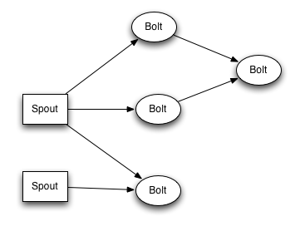
Apache Storm
It is a system which has distributed real time abilities i.e. we can execute all kinds of manipulations on real-time data in parallel.
The data flow in our system will go as follows
real-time-system → Storm → Kafka→ MySQL → D3.js → Web App
Storm is fault tolerant also which is also an advantage here. It consumes data from sources (Spouts) and passes it to pipelines (Bolts). We need to combine both of them to make a topology which is a graph with different nodes.
Each node in storm executes in parallel we can also decide the amount of parallelism we want for each node then storm will execute them in a multi-threading environment across the cluster to do the execution.
Storm uses Tuples as its data type so we have to send and receive data in this format.

Slide 8
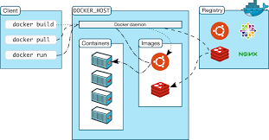
Docker
Since this web app will be built on a specific system simulating the same environment wherever this app is being used is very difficult.
Hence we use Docker for pushing the image of this web app on docker.io.
Problem Associated:- Docker runs on top of a Linux machine but all users wont have that. Solving the problem we can install a virtual machine as to run the Docker image.
Advantages with it are unlimited. When we pull the Docker image all the libraries and frameworks related with the application are also fetched so no need to download any additional libraries or frameworks.
Also the same Web App can have multiple instances on the same machine until all resources on our virtual machine are exhausted.

